Slide 1
MDE Work on Small EGU Temporalization & ERTAC EGU Inventory Split Updates for 2016 Platform
2016 Modeling Platform EGU Workgroup Call 9/27/18

Slide 2
Overview of Small EGU Temporalization Work for 2011 Platform
Identified a list of potential small non-CAMD EGUs based on MARAMA Gamma 2011 platform
Units that generally operate during peak demand periods
Identified based on NAICS and SCC code
Created daily temporal profiles based on CEMS data from larger “peaking” units
4 regions x 3 fuel bins (coal, oil, gas) = 12 profiles
Distributed list of units to states for review
Received comments from 15 out of 36 states
Used EMF to create FF10 hourly files which apply temporal profiles to small EGU units
Note EPA uses the FFF10 daily file format to process temporalized emissions for nonCEMS EGUs

Slide 3
Status of Small EGU Temporalization Work for 2016 Platform
Matched 2011 list of small EGU units to 2016 point sources. Split into two groups:
Units that were confirmed as small EGUs in 2011 platform based on state comment
Units where state did not provide comment
Ideally would do another round of outreach for these units before Beta platform is finalized
Created 2016 daily temporal profiles based on CEMS data from larger “peaking” units (same methodology as 2011 platform)
Now 13 profiles (added WESTAR gas profile)

Slide 4
What went into creating the 2016 profiles?
Identified 2016 “peaking EGUs” that report to CAMD, based on the definition from EPA’s 2011v6.1 Emissions Modeling Platform
Downloaded 2014-2016 CAMD data for all units with source category listed as Electric Utility, Cogeneration, or Small Power Producer
Full year reporters only
Identified units with a 3-year average capacity factor <10%, and capacity factor <20% in each of the 3 years analyzed
Separated into region and fuel type bins
5 regions: MANE-VU+VA, LADCO, SESARM, CenSARA, WESTAR
3 fuel bins (based on primary fuel): coal, oil, gas
Aggregated daily heat input for each region/fuel bin. Calculated daily fraction of annual heat input.
Notes:
https://www.epa.gov/sites/production/files/2015-08/documents/2011v6.1_2018_2025_base_emismod_tsd_nov2014_v6.pdf

Slide 5
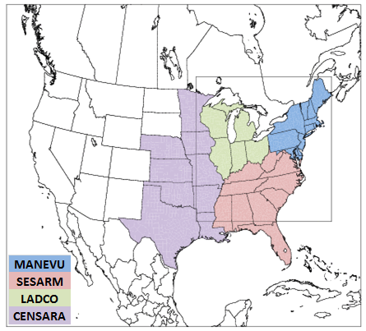
How many units in each region/fuel bin?
 | Number of units in fuel bin
 | Coal | Oil | Gas
CenSARA | 2 | 25 | 325
LADCO | 7 | 38 | 374
MANE-VU + VA | 11 | 137 | 214
SESARM | 8 | 145 | 346
WESTAR | - | - | 259
Total: | 28 | 345 | 1,518
Notes:
Note WESTAR is not labeled in map. Update later if possible. Also note that VA was included in the MANE-VU regional profiles, to be consistent with ERTAC

Slide 6
Compare 2016 and 2011 Peaking Profiles – Coal

Slide 7
Compare 2016 and 2011 Peaking Profiles – Oil

Slide 8
Compare 2016 and 2011 Peaking Profiles – Gas

Slide 10
Diurnal profiles
Voluntary data collection from MD facilities showed that units typically operated 1-12 hours per operating day, but did not receive data on times of day
For 2011 platform, MDE split daily emissions evenly across all hours 10 am – 8 pm
10% of daily emissions allocated to each hour
EPA suggests using EGU CEMS data to create diurnal profiles (re: diurnal profiles from 9/14/18)
Same 5 regions as MDE’s annual-to-day profiles
Separate diurnal profiles for summer and winter
4 fuel-based profiles: coal, gas, other, composite

Slide 11
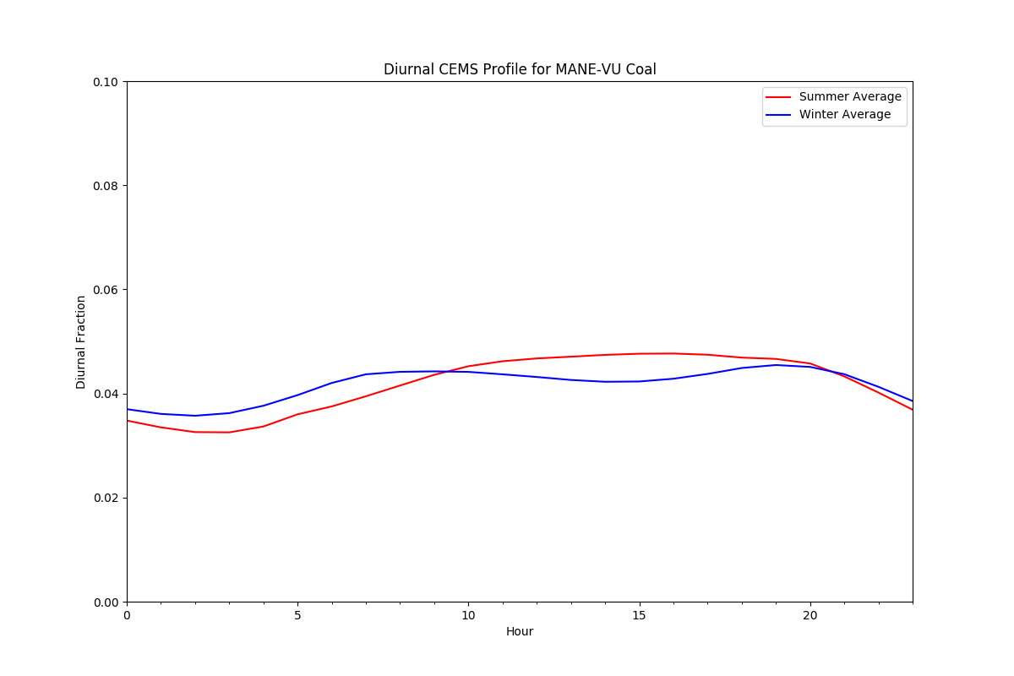
MANE-VU

Slide 12
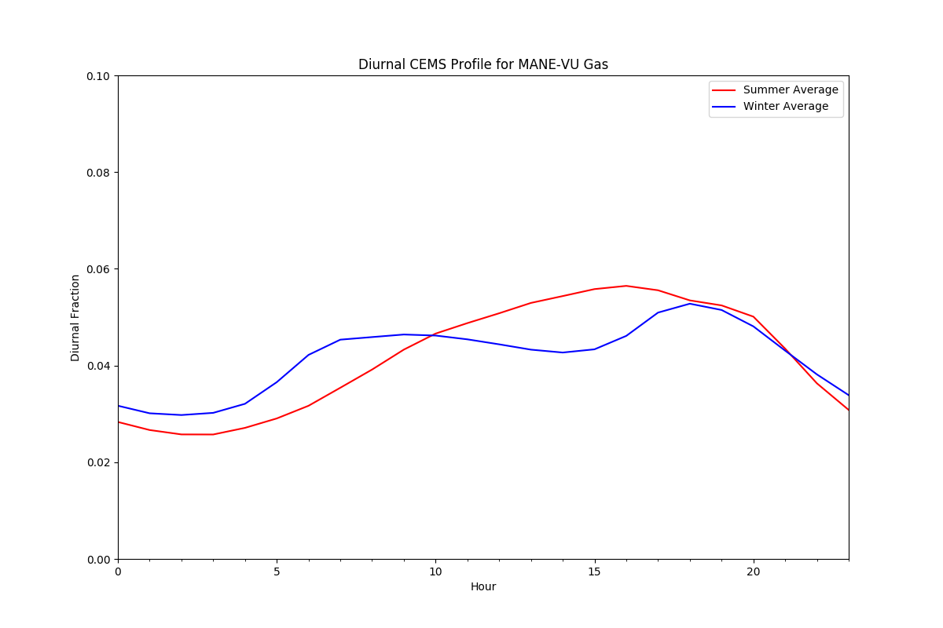
MANE-VU

Slide 13
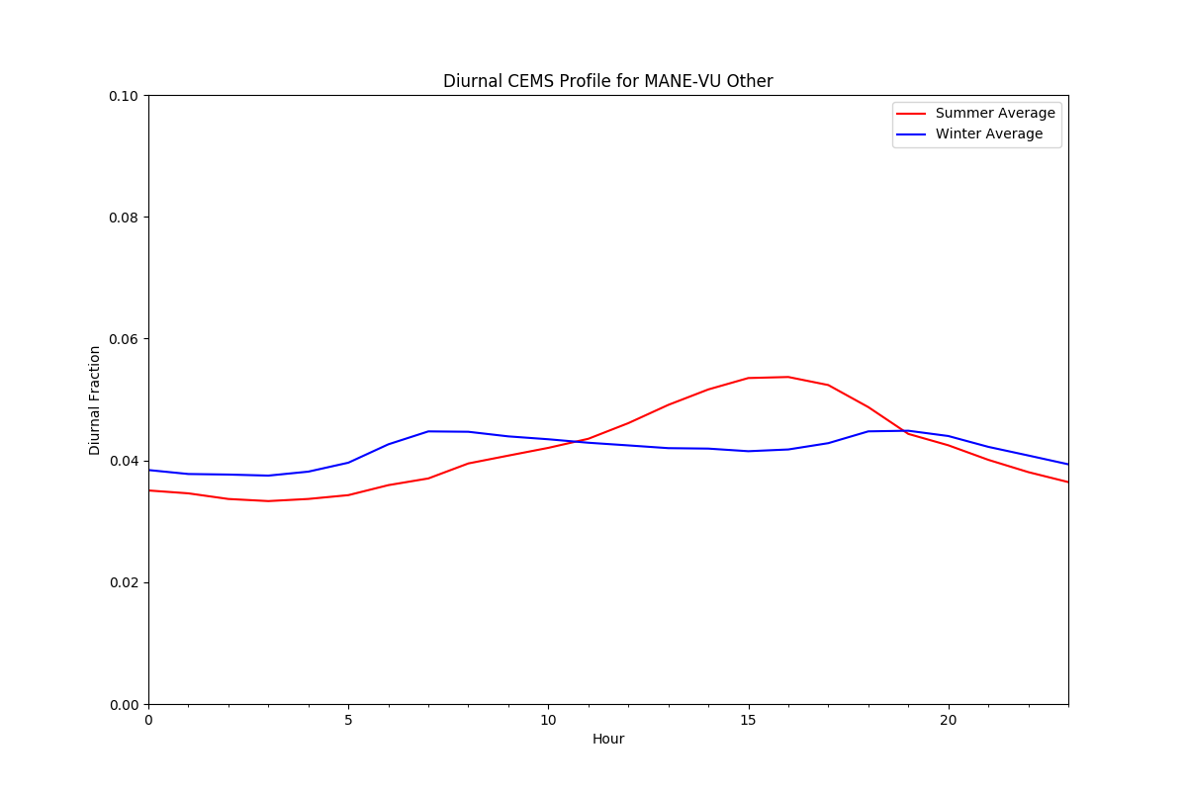
MANE-VU

Slide 14
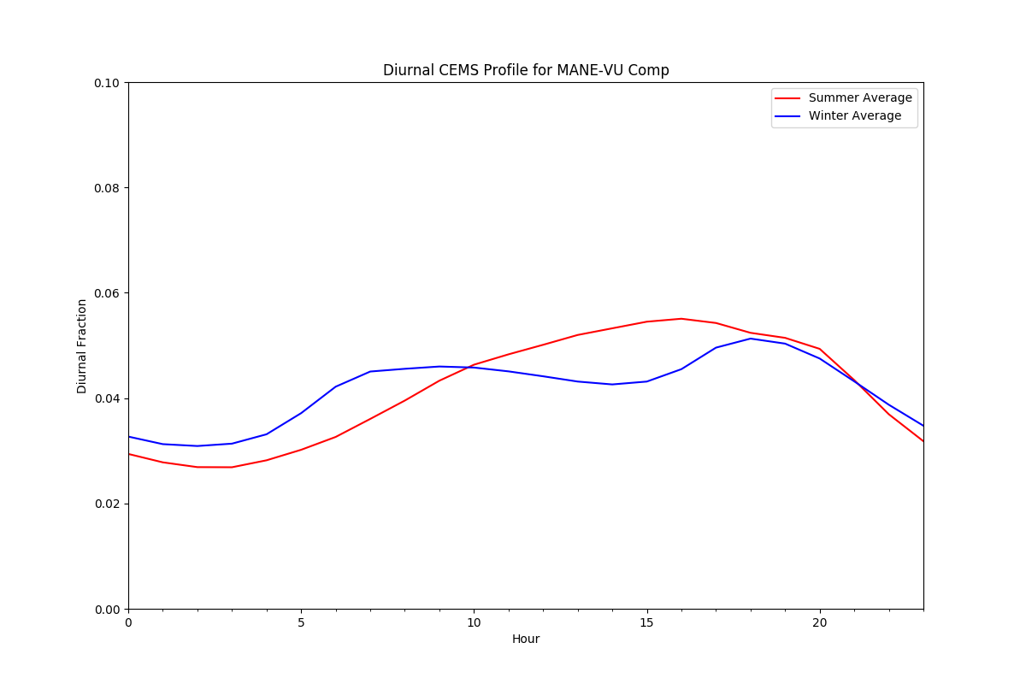
MANE-VU

Slide 15
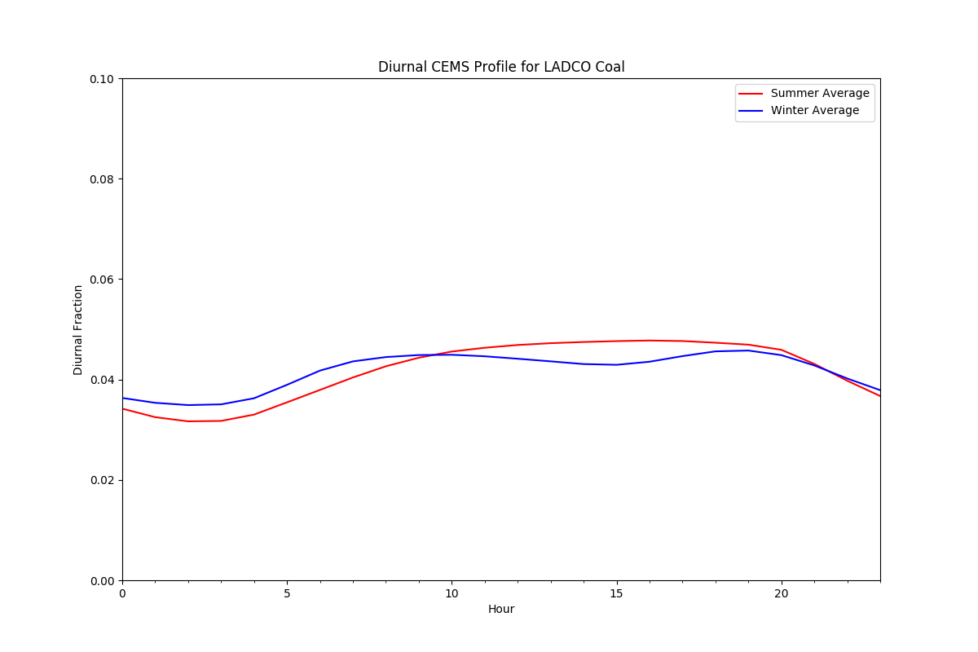
LADCO

Slide 16
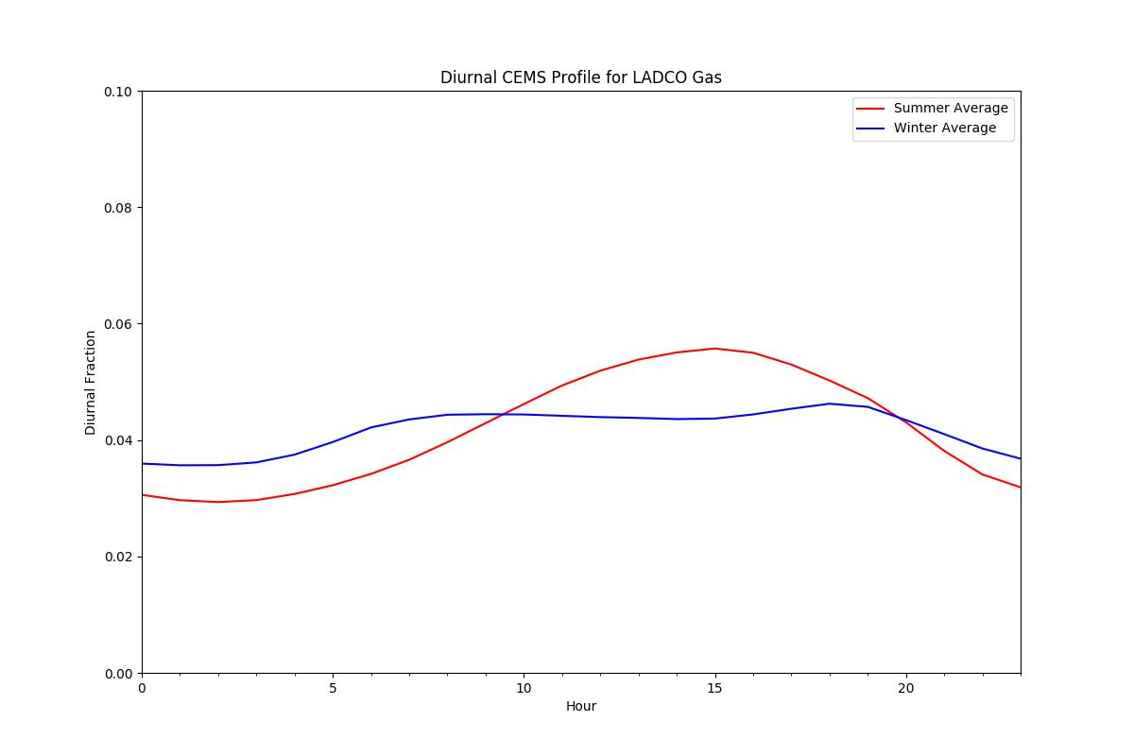
LADCO

Slide 17
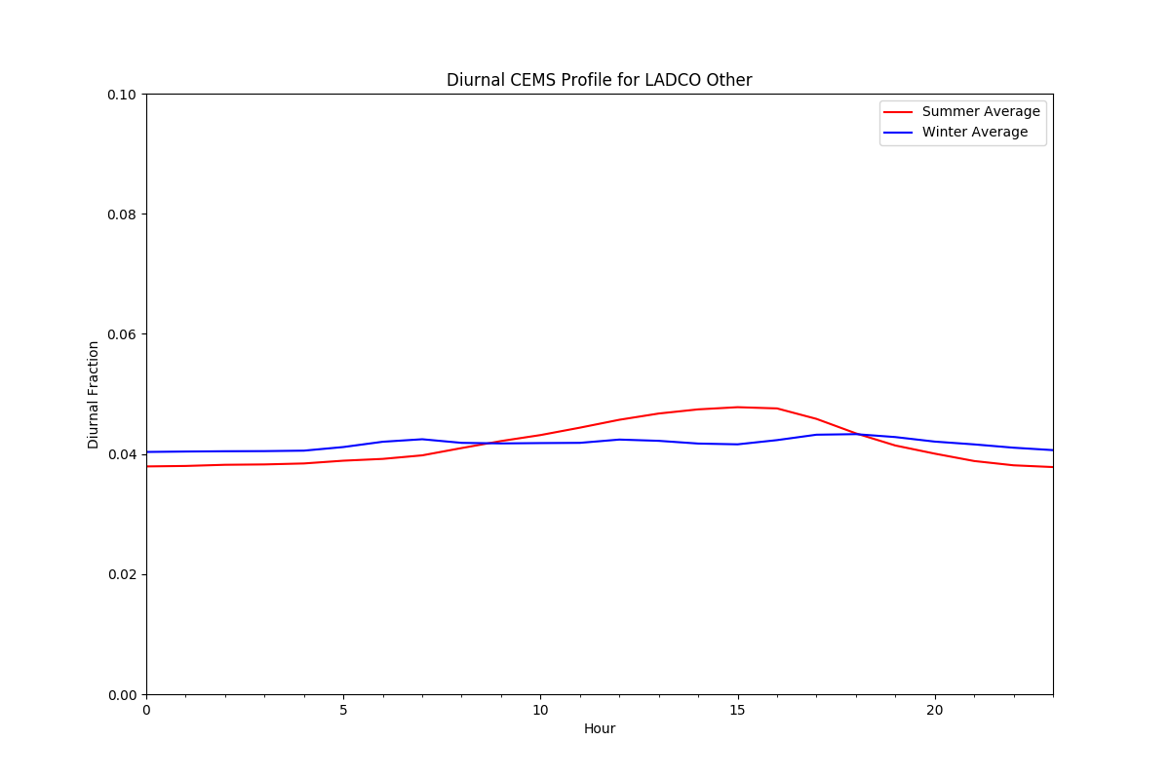
LADCO

Slide 18
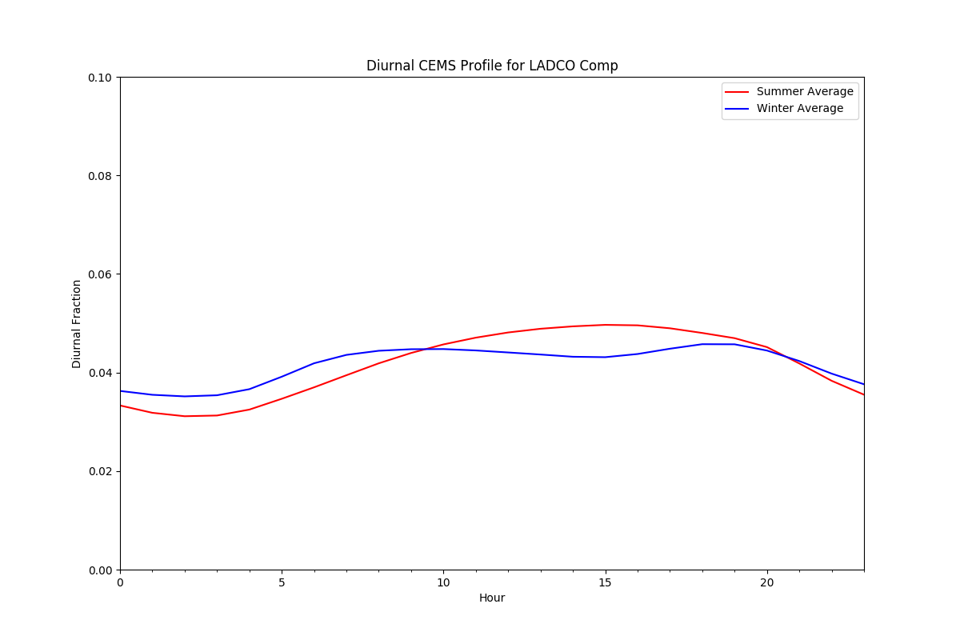
LADCO

Slide 19
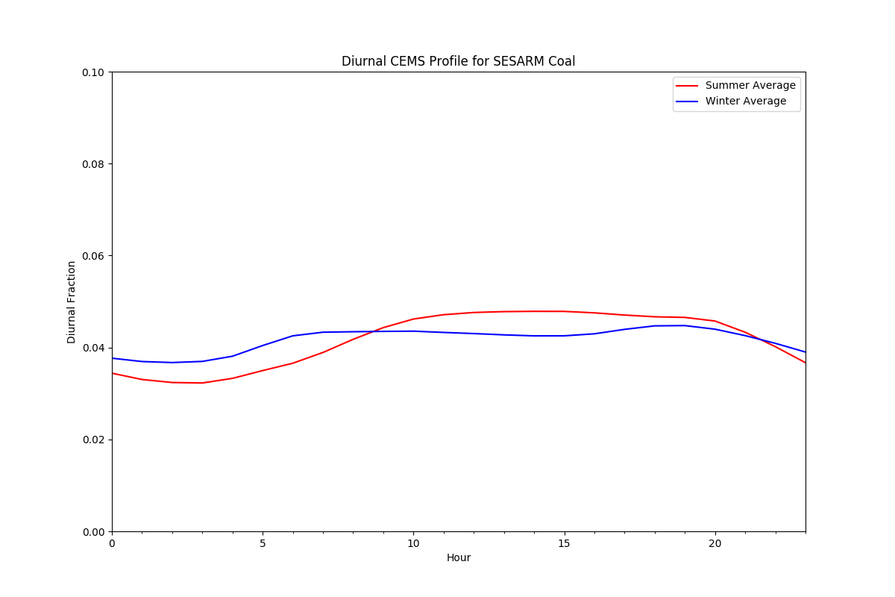
SESARM

Slide 20
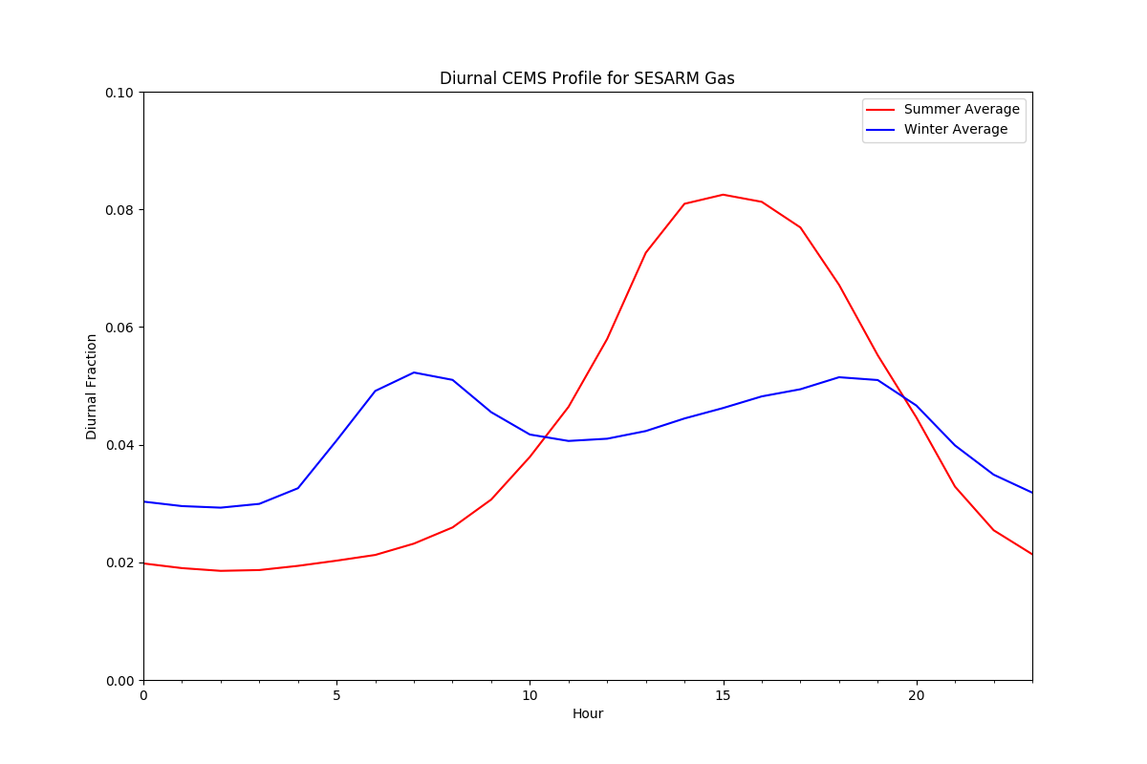
SESARM

Slide 21
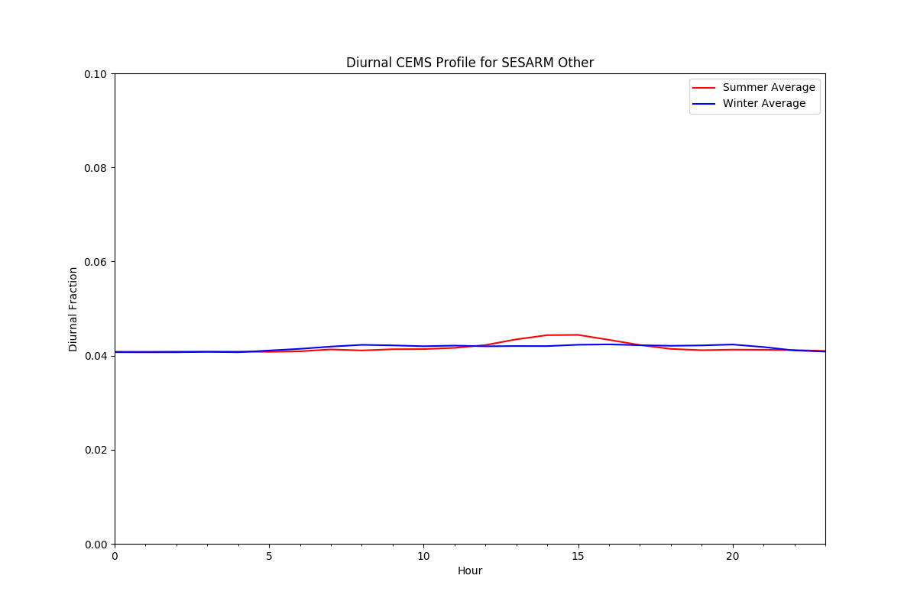
SESARM

Slide 22
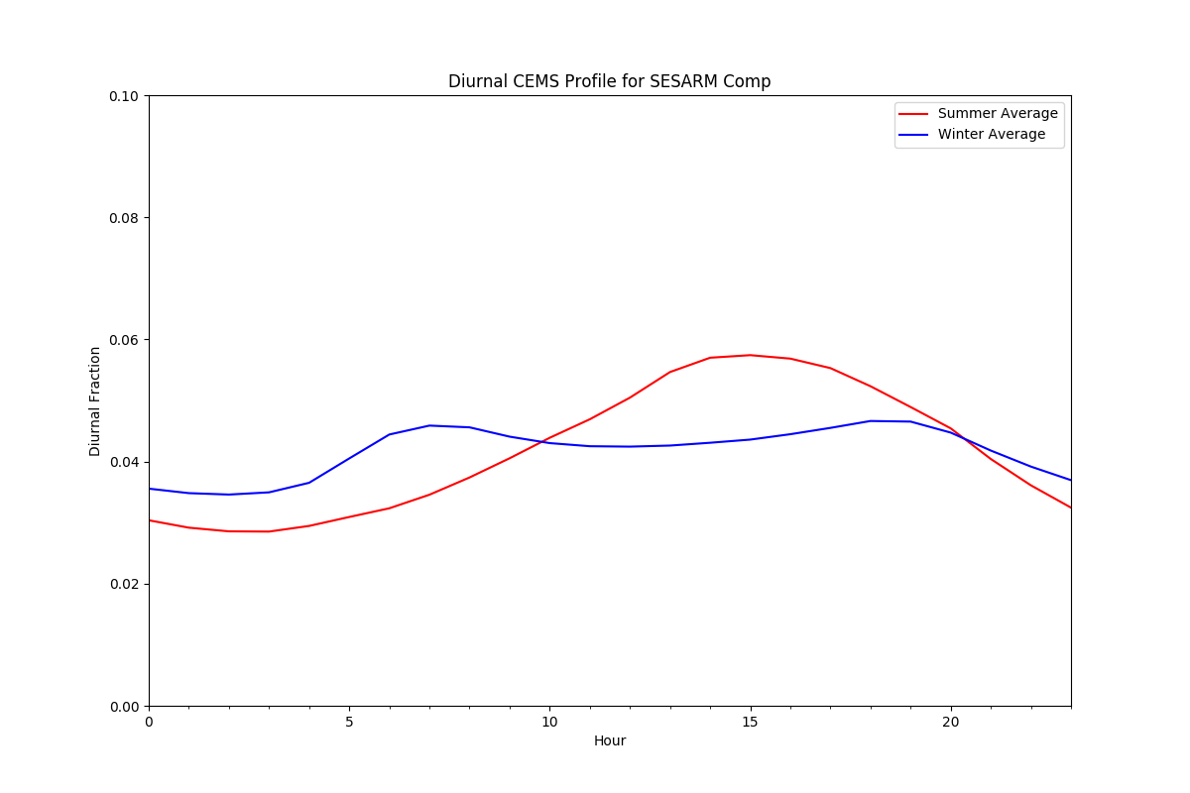
SESARM

Slide 23
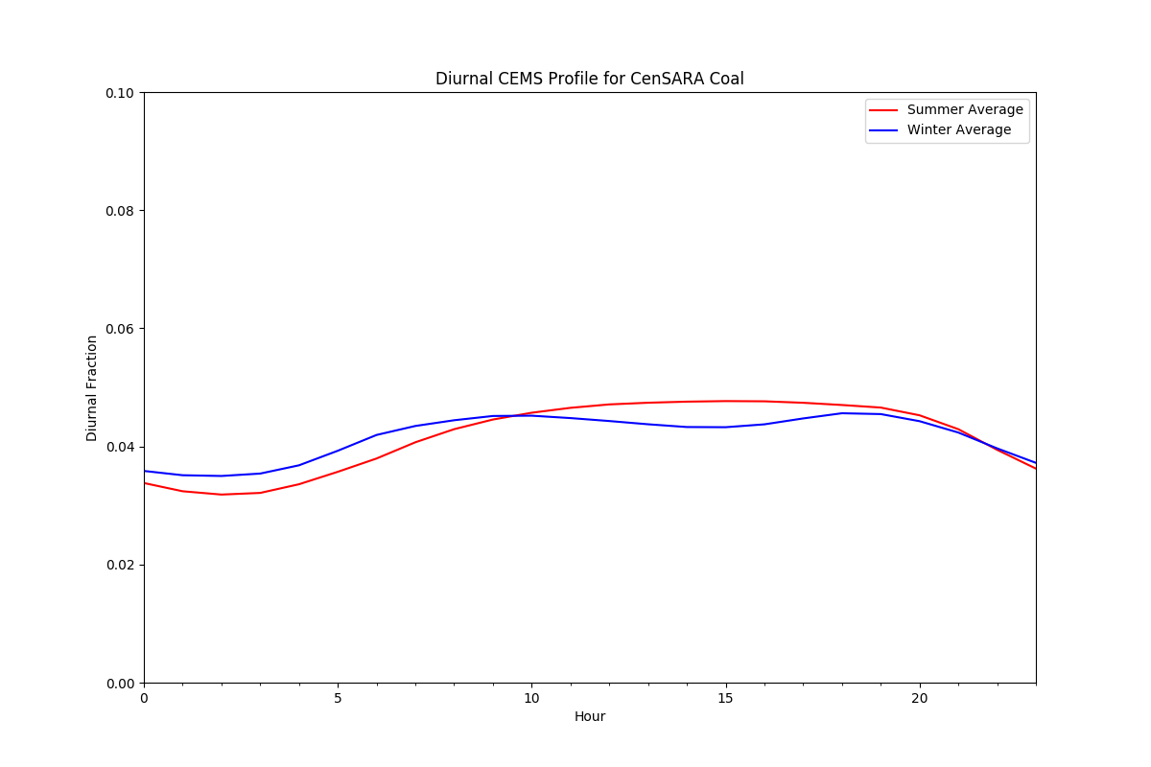
CenSARA

Slide 24
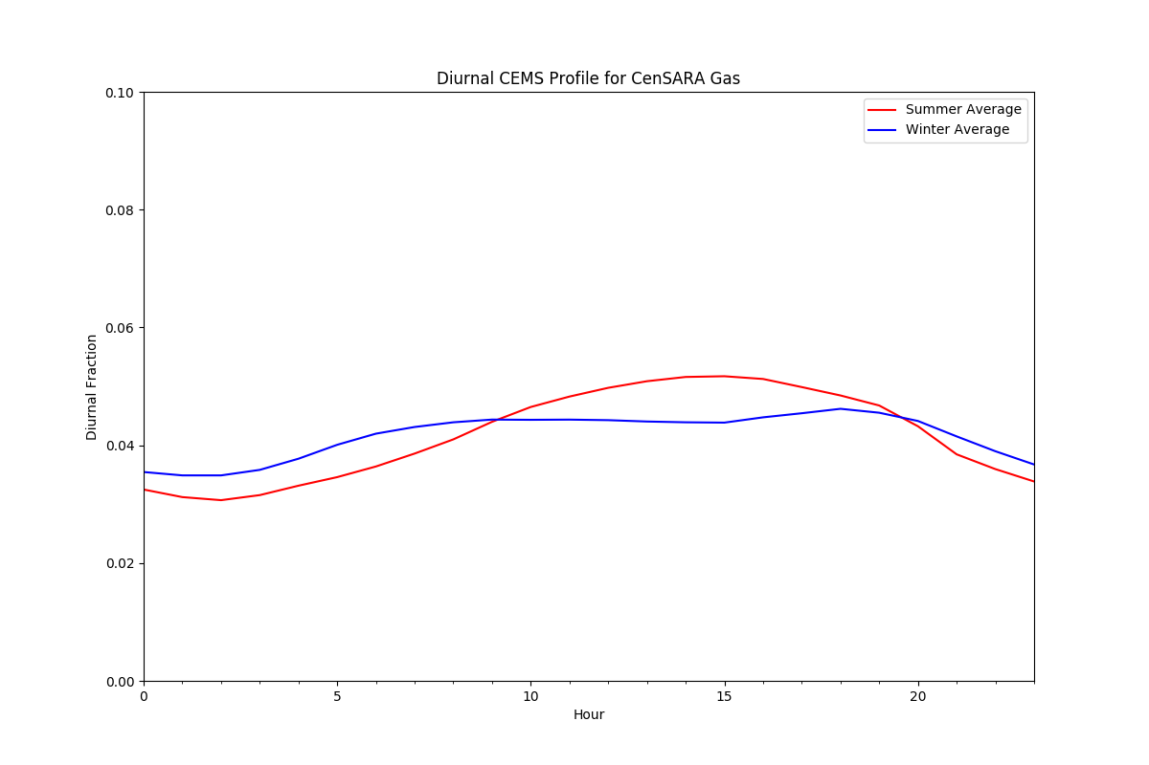
CenSARA

Slide 25
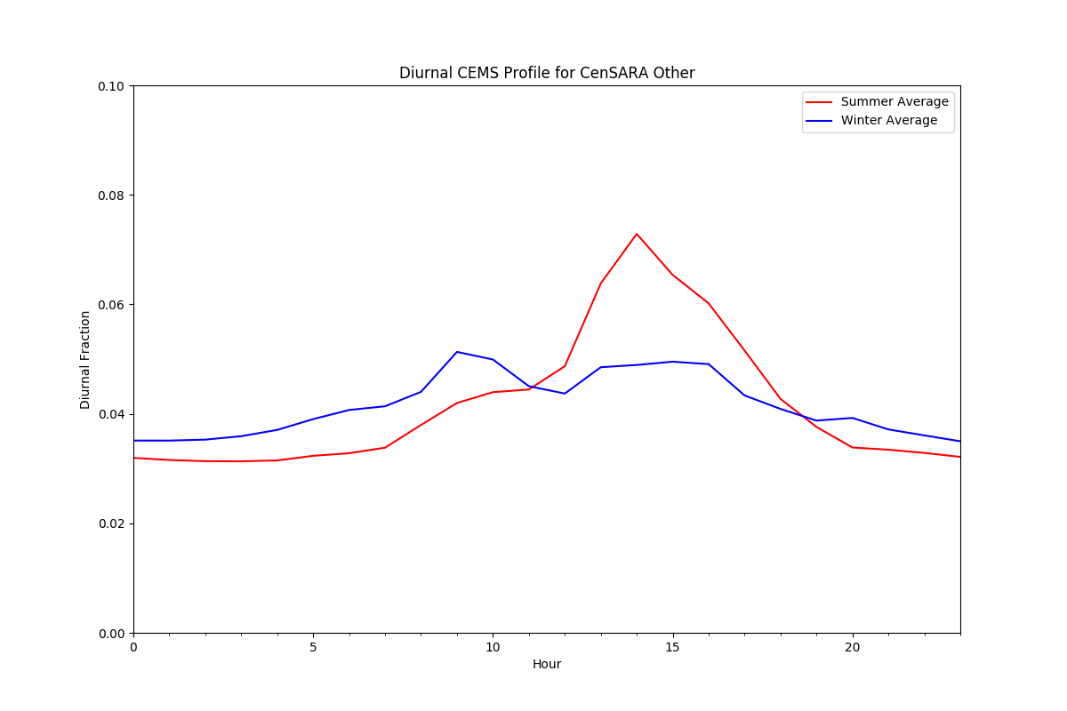
CenSARA

Slide 26
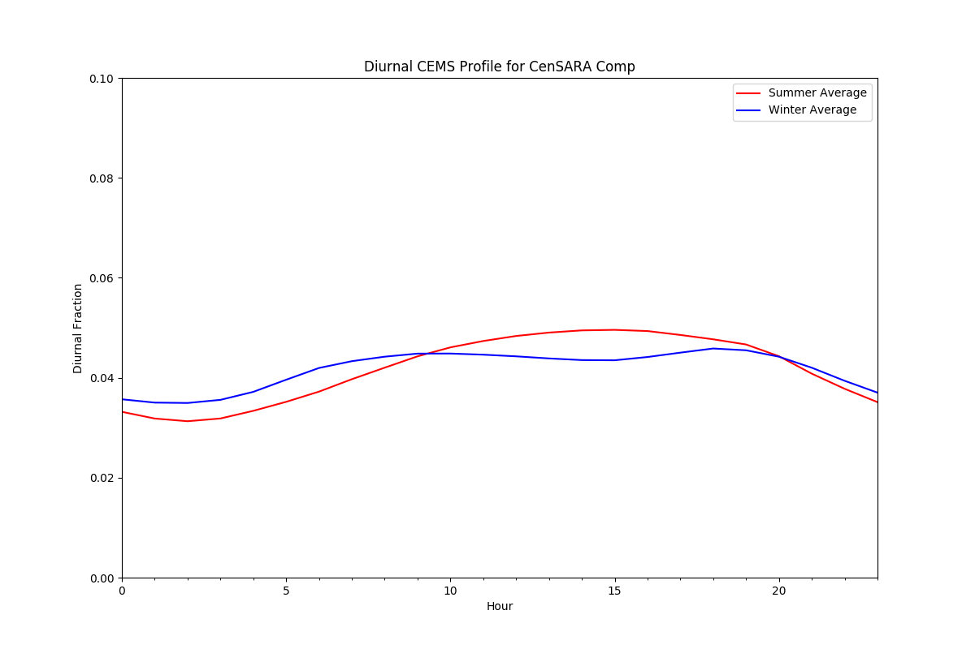
CenSARA

Slide 27
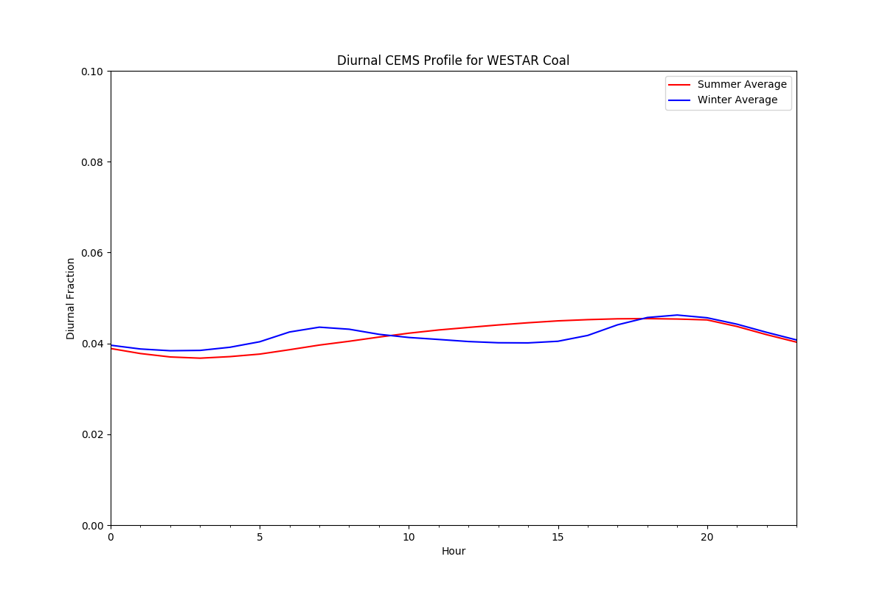
WESTAR

Slide 28
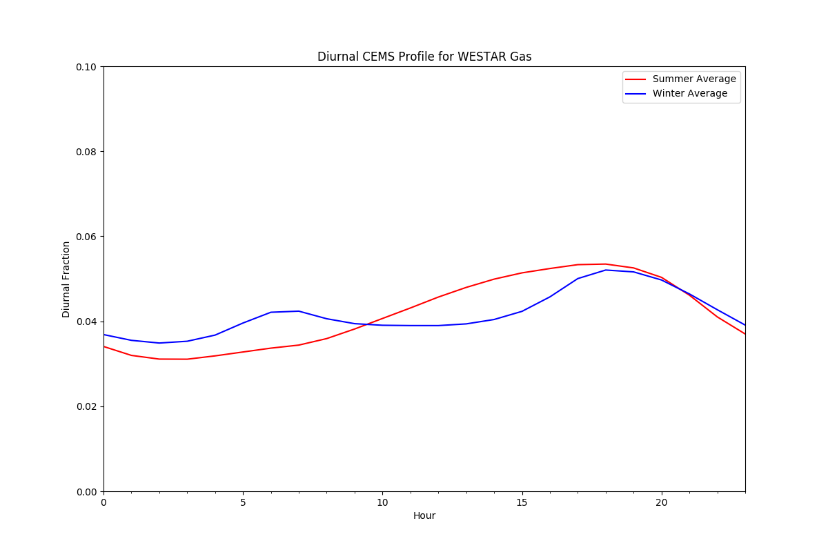
WESTAR

Slide 29
WESTAR

Slide 30
Notes on Diurnal Profiles
Questions for EPA on what went into the diurnal profiles:
Are these profiles based on all CAMD-reporting units? If so, could this be replicated using only specific “peaking” units?
What types of fuels went into the “other” category? It would be helpful to have an oil profile to correspond with fuel bins for annual-to-day profiles.
Concerns with diurnal profiles for MANE-VU region
Data collected by MDE shows that small EGUs only operate for short periods during the day. It would be inappropriate to allocate emissions to nighttime hours.
MD data is a small sample size. Comments from other states?

Slide 31
What units will the profiles be applied to?
MDE identified potential small EGUs from the 2011 MARAMA Gamma Emissions Modeling Platform, using a combination of NAICS and SCC codes
Used NAICS code of ‘22111’ or ‘221112’ to identify the facility type as electric generating facility
Used SCC to identify fuel/unit type – coal boilers, oil & gas turbines/RICE
MDE solicited state comments. For states that provided comments, units determined not to be small EGUs were removed.
Matched 2011 list of small EGUs to EPA’s 2016 Alpha modeling platform point files
For WESTAR, replicated process used for 2011 platform (based on NAICS and SCC) using EPA’s 2016 Alpha modeling platform

Slide 32
Notes:
Note some units have retired, some have reduced emissions over time

Slide 33
Notes:
Drop in NOx emissions in many states due to retirements, and also due to improved matching between EIS and CAMD units

Slide 34
Notes:
No 2011 emissions to compare for WESTAR because they were not included in original 2011 platform work

Slide 35
Next steps for Small EGU Temporalization
For 2016 Beta platform, recommend including all small EGUs (confirmed and unconfirmed) in temporalization scheme
Before 2016v1 is finalized, complete state outreach. States should comment on:
Individual units identified as small EGUs (Y/N)
Annual-to-day and diurnal profiles – are they appropriate for your state?
States can ask sources to voluntarily provide 2016 operating data to validate the methodology, similar to MDE’s effort

Slide 36
Point Inventory Sector Split
IPM platform sectors:
IPM
pt oilgas
ptnonipm
EGU nonCEMS
EGU CEMS
ERTAC platform sectors:
pt oilgas
small EGUs (temporalized)
MWCs and cogens
ERTAC EGUs
ptnonipm
ptnonERTAC_IPM
Notes:
Point oil & gas sectors are identical between the two platforms
Ptnonipm sector is nearly identical. In the 2011 platform, MDE identified many “small EGUs” in EPA’s ptnonipm file. It seems EPA has mostly fixed this issue by improving its NEEDS crosswalk for the 2016 platform. MDE will QA the 2016 files to see if there are any small EGUs that remain in the ptnonipm sector.
MARAMA’s “ptnonERTAC_IPM” sector consists of some units that are small EGUs and some that are MWCs and cogens. These should all be temporalized differently. Need to discuss further how these will be temporalized.
Another question – in 2011 platform, found some ERTAC units in the ptnonipm file. Was likely a result of a bad match. Need to QA to see if this problem persists.

Slide 37
Process for 2016 Alpha Inventory Split
Crosswalk work has been completed – able to significantly improve match between CAMD/ERTAC/IPM units
EPA inventory split matches EIS facility, unit, stack, and process IDs from point inventory to IPM units
ERTAC platform uses only EIS facility and unit to match to ERTAC and small EGU (non-ERTAC) units
Will provide EPA with a list of EIS facility and unit IDs along with sector name to facilitate inventory split

Slide 38
Extra Slides

Slide 39
2011 Data
2016 Data
26 out of 40 MD oil-fired units submitted data:
Philly Rd 1-4
Riverside 7-8
CP Crane CT
HA Wagner CT
Easton (18 units)
Chalk Point CT
Notes:
Here we have the profile that MDE developed for MANEVU oil in blue, and the actual aggregate operating profile for MD small oil-fired units. As you can see, the MDE profiles match up well with the operational data; we are seeing peaks occur on similar days. There are differences in the magnitude of the peaks, but this is likely a function of averaging. We have only 27 oil-fired units in MD that have reported so far, compared to a much larger number of units included in the MANEVU oil profile, so they are operating on fewer days.

Slide 40
2011 Data
2016 Data
Notes:
Here we can see the profile that MDE developed for MANEVU gas in orange, and the actual operating profile for MANEVU gas units in green. We only have 8 small gas-fired units in MD, at Notch Cliff, but similar to oil, you can see that the profiles match up well.

